Slide 1

Drinking Water Quality in Minnesota municipal water supply systems Thu Nguyen, Beryl Kaczmarczik, Matt Pollari, Susan Roedl, Erin Mandell

Slide 2
Intro / Purpose of our project
Who in Minnesota has access to safe drinking water?
Do wealthy and poor regions of Minnesota have different levels of access to safe drinking water?
Our hypothesis was that low income areas would have poorer water quality than wealthier areas.
We chose 3 contaminants to research:
1) arsenic is a naturally occurring element and it also is found in pesticides
2) nitrate comes from runoff of fertilizers, animal waste and failing septic systems
3) uranium is a naturally occurring heavy metal present in southwest and northeast Minnesota

Slide 3
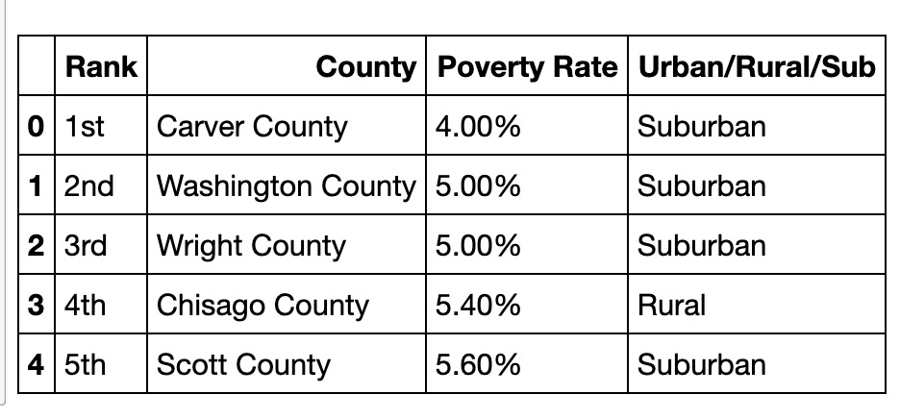
Data Cleaning Process
Two main sets of data:
Poverty rates that came from https://www.welfareinfo.org/poverty-rate/minnesota/
And they list their Source: as 2010-2017 ACS 1 Year
Second set of data for the contaminants came from https://data.web.health.state.mn.us/drinkingwater_query

Slide 4
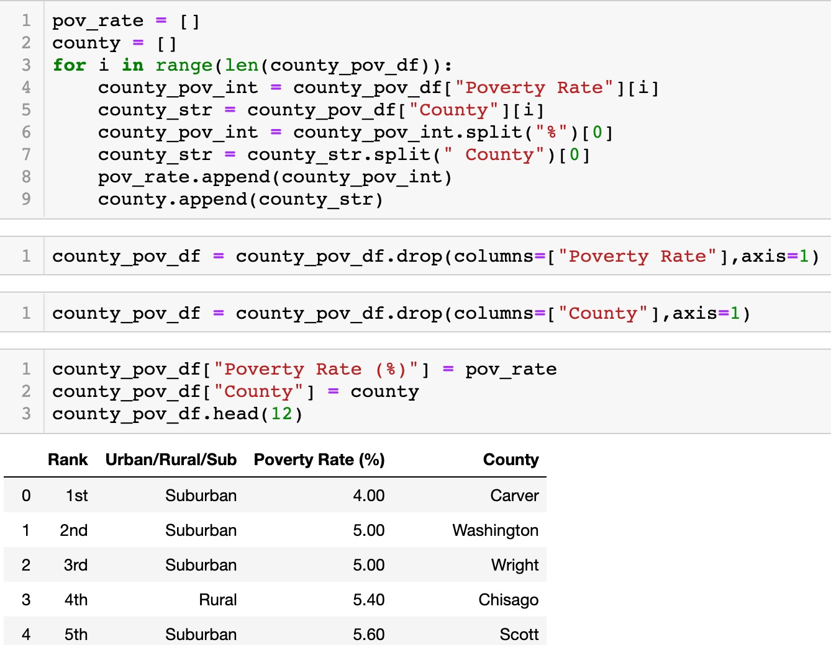
Data Cleaning Process Code for Cleaning

Slide 5
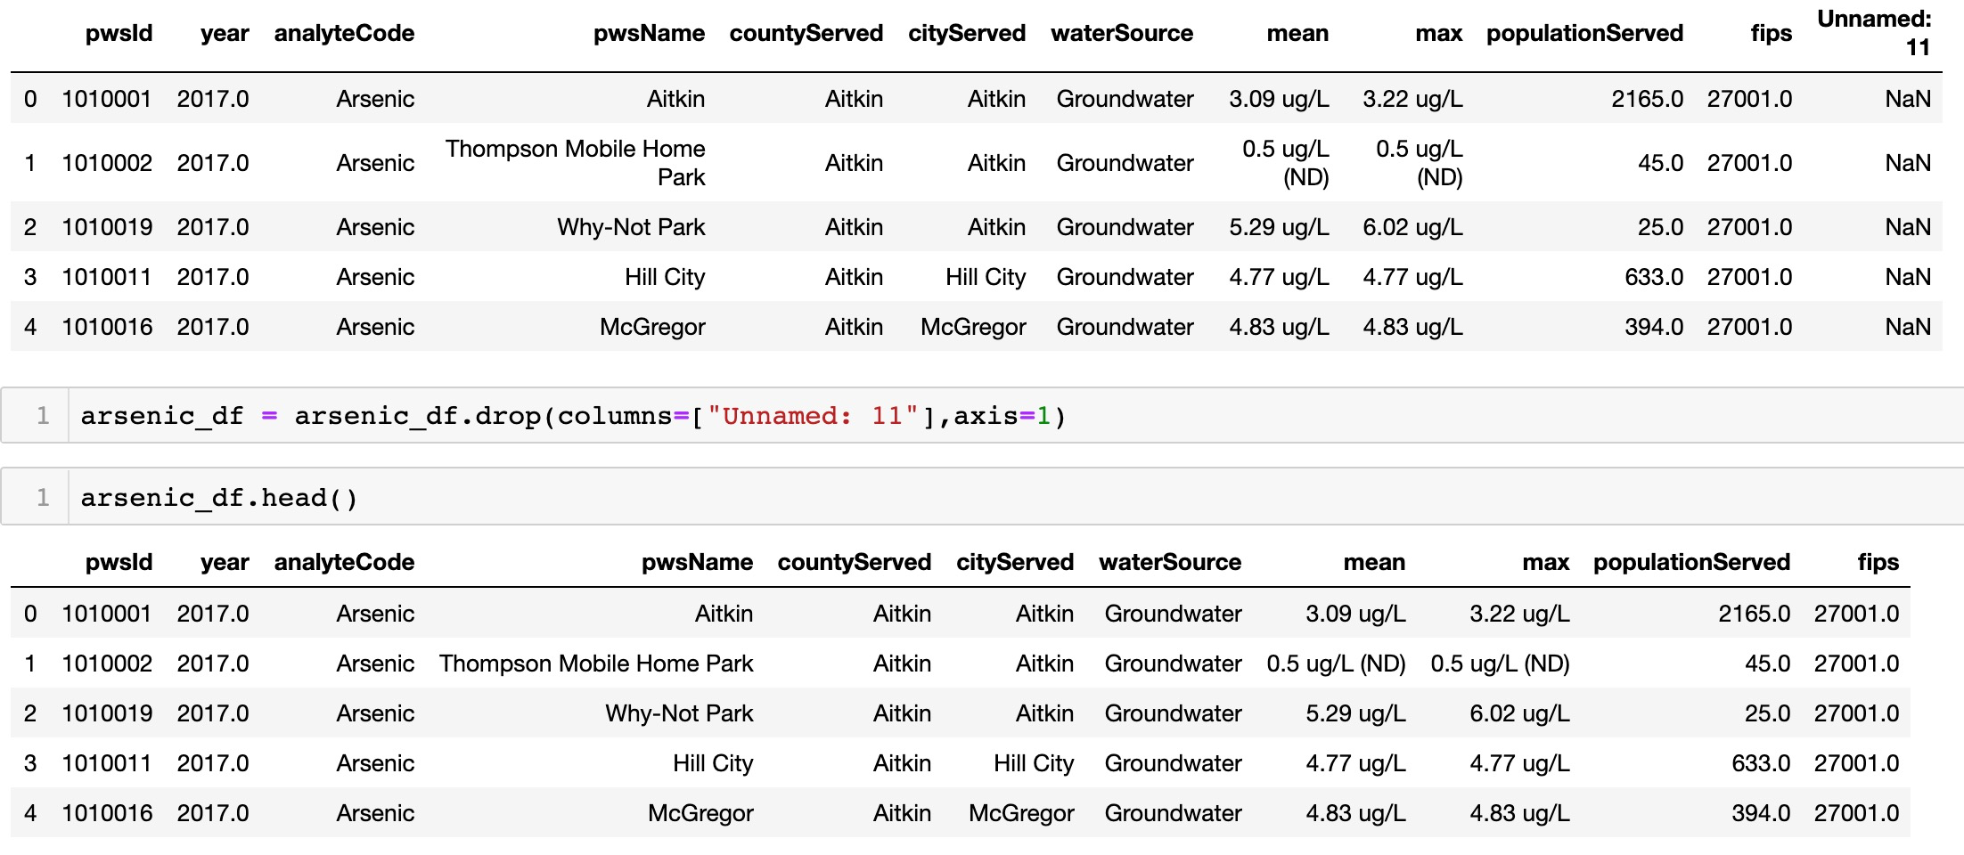
Data Cleaning Process Dropping Column

Slide 6
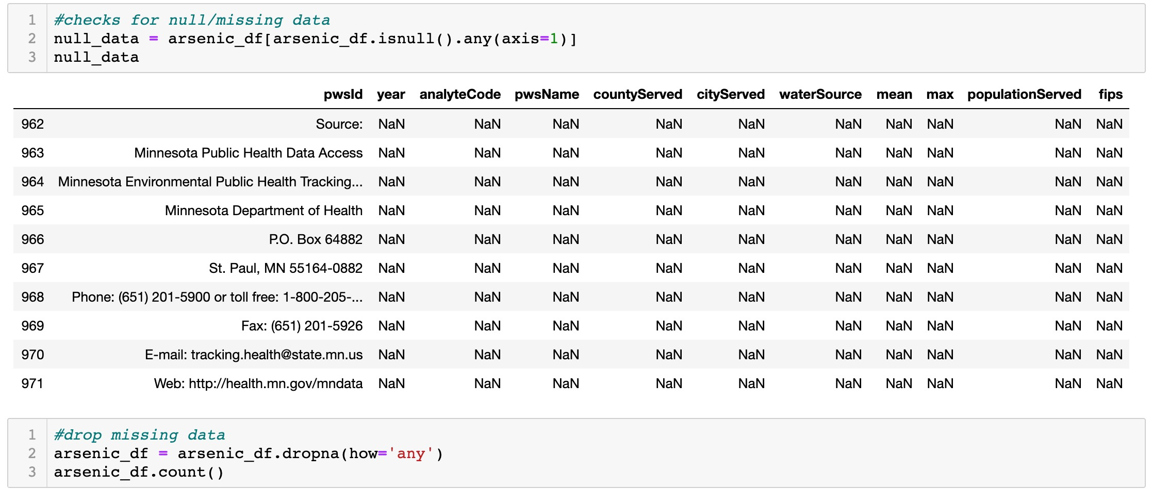
Data Cleaning Process

Slide 7
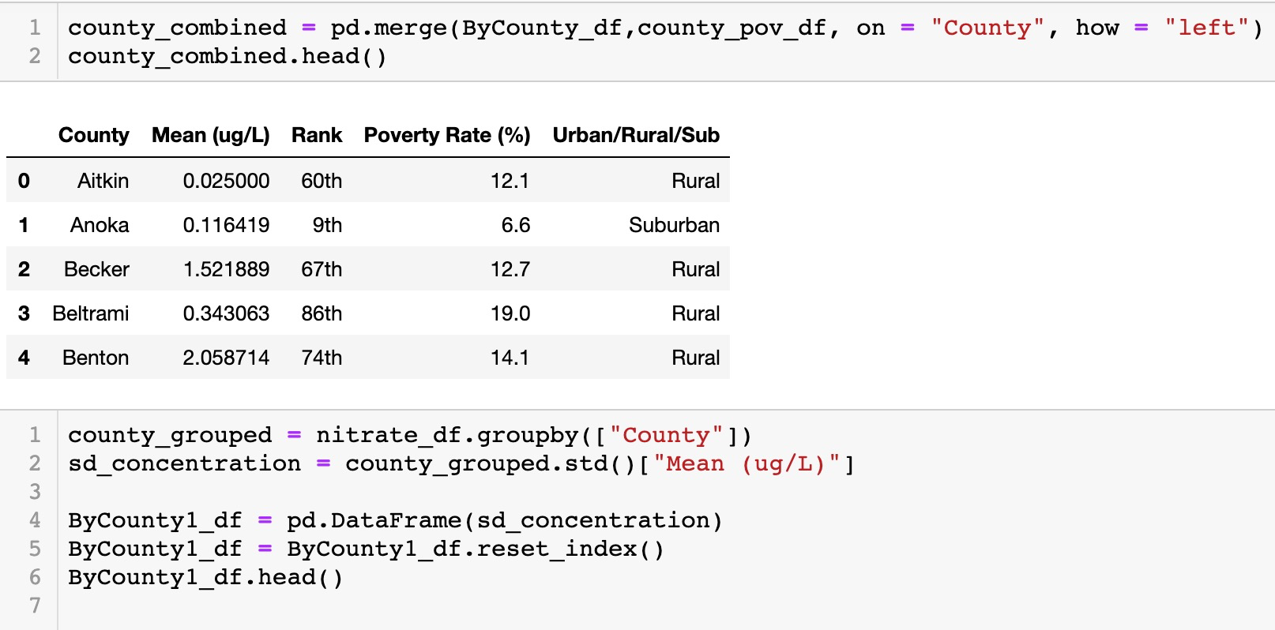
Data Cleaning Process Merging

Slide 8
Statistical Analysis
Research Questions:
Question 1: Is there a significance difference between the mean concentration of a particular contaminant in a group compared to other groups?
Question 2: Is there a significance difference between the mean concentration of a particular contaminant in the wealthiest counties compared to the poorest?

Slide 9
ANOVA (ANalysis Of VAriance)
Question 1:
𝛍1: the mean concentration in bin 1
𝛍2: the mean concentration in bin 2
….
𝛍5: the mean concentration in bin 5
Null Hypothesis:
The population means of the bins are equal
Alternative Hypothesis:
At least one population mean differs from the others

Slide 10
ANOVA
Recall:
F = variance between groups/variance within groups
p-value = probability of obtaining test results greater or equal to F-statistic under the assumption of the Null Hypothesis
Results:
F = = 1.642
p-value = 0.172
Conclusion:
Fail to reject the Null Hypothesis
No significant evidence that there’s a difference in the concentration of Arsenic among the five bins

Slide 11
t-test (Monkeying around) 🙈
Question 2:
Assumption: Unequal variance
𝛍1: the mean concentration in bin 1 (wealthiest)
𝛍2: the mean concentration in bin 5 (poorest)
Null Hypothesis:
The two population means are equal
Alternative Hypothesis:
One population mean differs from the other

Slide 12
t-test (Monkeying around) 🙈
Results:
T = -0.488
p-value = 0.629
Conclusion:
Fail to reject the Null Hypothesis
No significant evidence that there’s a difference in the mean concentration of Arsenic among the wealthiest vs poorest counties

Slide 13
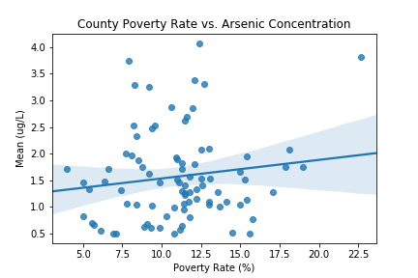
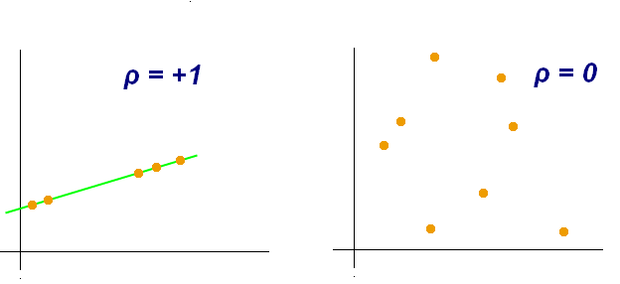
Seaborn is a Python data visualization library based on matplotlib
Pearson Correlation Factor = 0.14

Slide 14
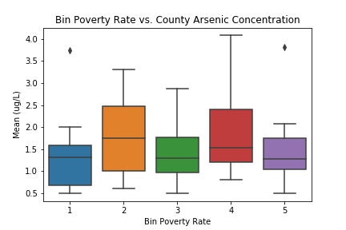
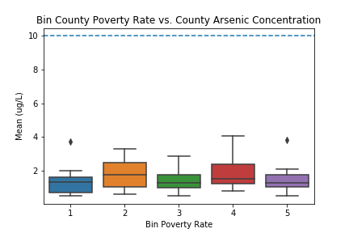
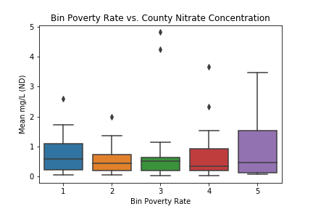
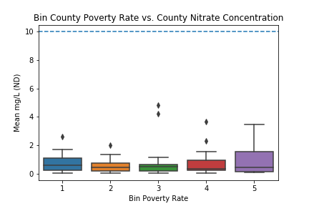
EPA maximum limit
Bin 1 = Counties with the Lowest Poverty Rates (wealthiest)
Bin 5 = Counties with the Highest Poverty Rates (poorest)

Slide 15
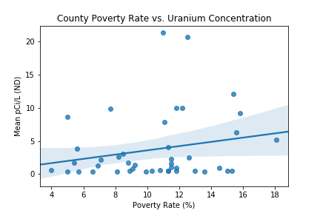
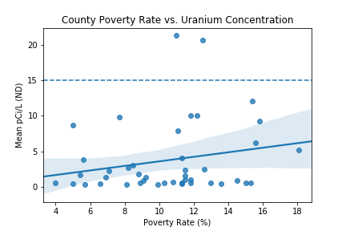
EPA maximum limit
Pearson Correlation Factor = 0.21
Rock and Yellow Medicine County

Slide 16
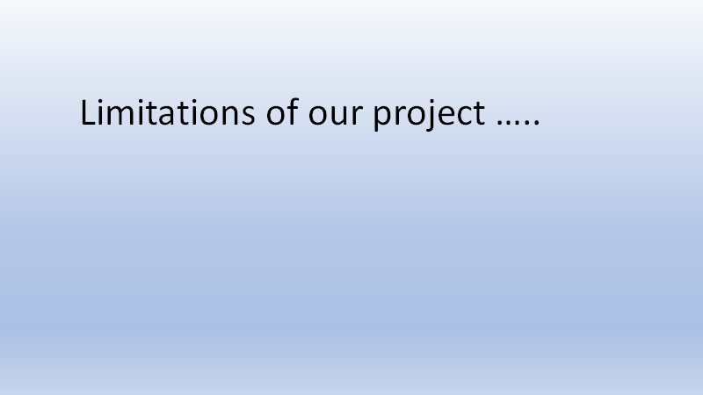

Slide 17
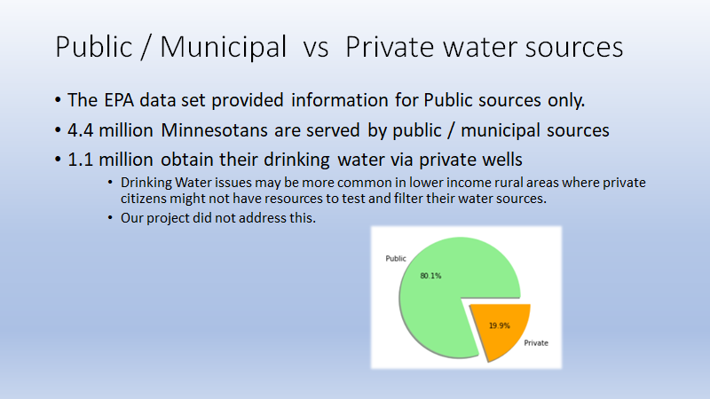

Slide 18
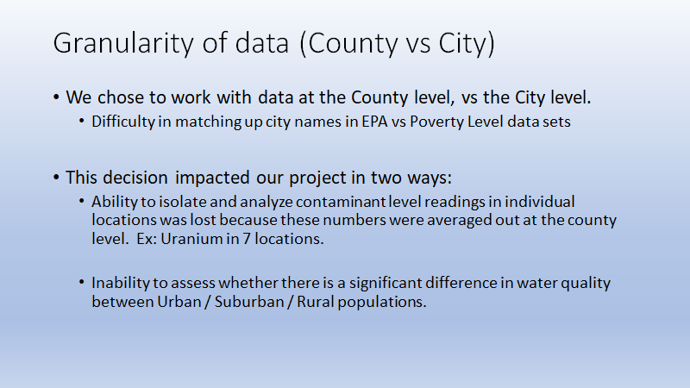

Slide 19
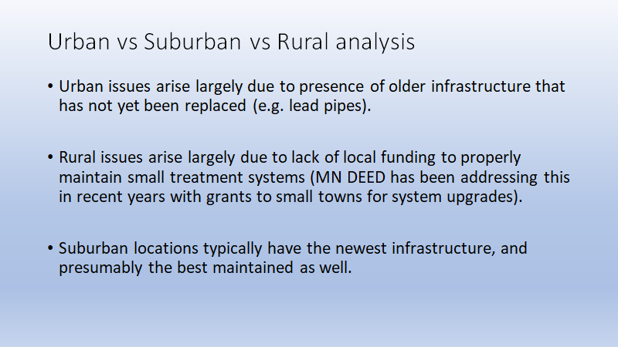

Slide 20
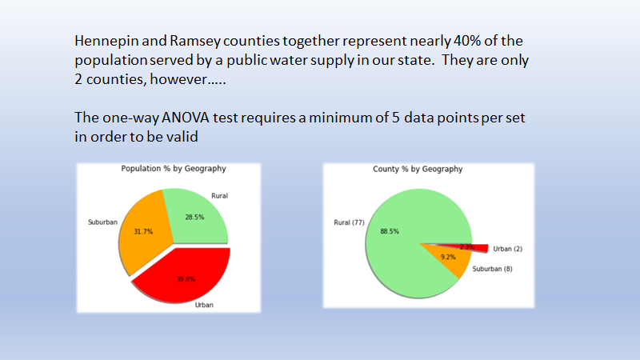

Slide 21
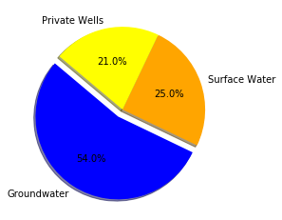
Implications and other lessons learned
Our research showed that most Minnesotans have access to clean water regardless of their income. That isn’t the whole story though.
One thing we learned is that it’s important to know your subject reasonably well so that you can choose a good data source.
Our data was limited to municipalities that treat water to remove these contaminants. Many people in rural and ex-urban areas use private wells for their water have high levels of some of these contaminants in their water unless they have the knowledge and money to treat it.
Minnesota improved it’s groundwater quality beginning in about 2007 so by 2017, the year we sampled the data, it much cleaner.
It is not clear whether the Indian Reservations in the Minnesota use municipal systems.
They make up some of the least wealthy areas in the state.
Bemidji is the 2nd poorest county in the state and they use wells for at least some of their water.
They had to close 3 of their 5 wells this year because they tested positive for PFC’s.
Sources: The Bemidji Pioneer (July 28, 2019)
Minnesota Department of Health

Slide 22


